Slide 1
Home
Nice videos of the vortex rings being produced
Synthetic Jet Demonstration
Touch anywhere to start!

Slide 2
Working Principle
A synthetic jet is a device that generates a jet without the need for an air supply.
A “breathing” nozzle produces a synthetic jet. The oscillatory motion is accomplished by a membrane driver, like a speaker or a piezoelectric element.

Slide 3
Working Principle
Vortex rings self-propel.
The synthetic jet works because it generates a vortex ring. A vortex ring is able to propel itself, carrying momentum away from the nozzle.
Animation explaining induced velocity from one vortex onto the other

Slide 4
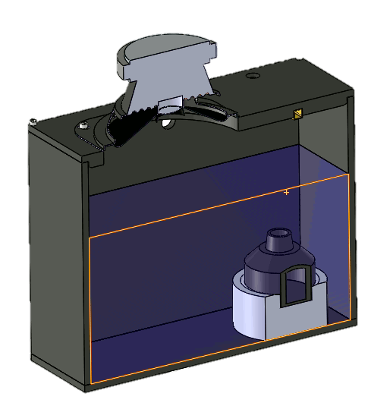
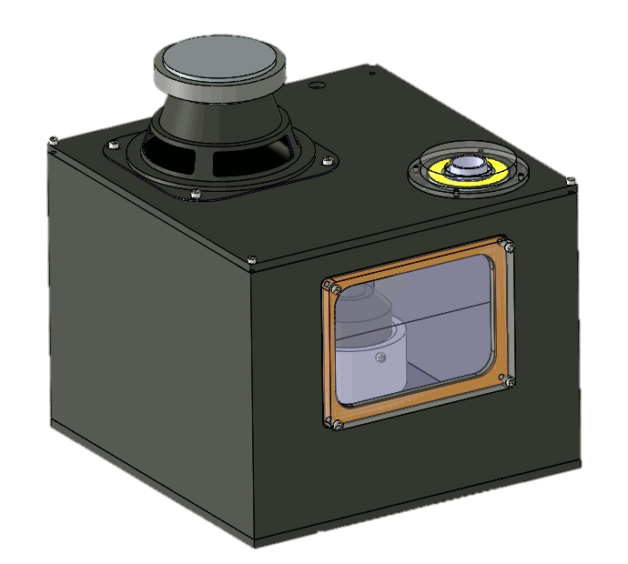
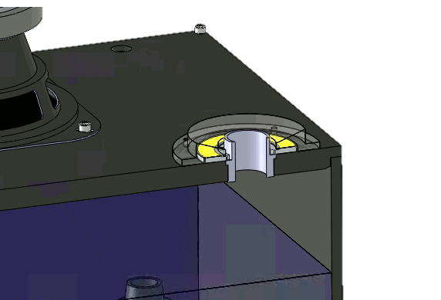
Working Principle
How this demo works
Animation explaining the specific setup used by this demo
Show cut with the speaker and the fog generator
Show simulated vortex rings coming from the nozzle
Show outside view

Slide 5
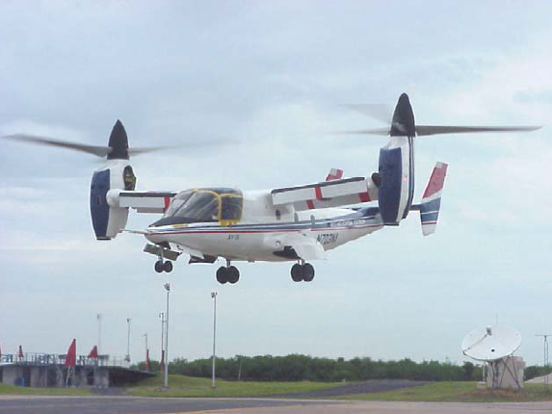
Applications
Download reduction on the XV-15 tilt-rotor
Show movie of the XV-15 / discuss the retrofit done by U of A; IIT
https://www.youtube.com/watch?v=mbnWhgk64so

Slide 6
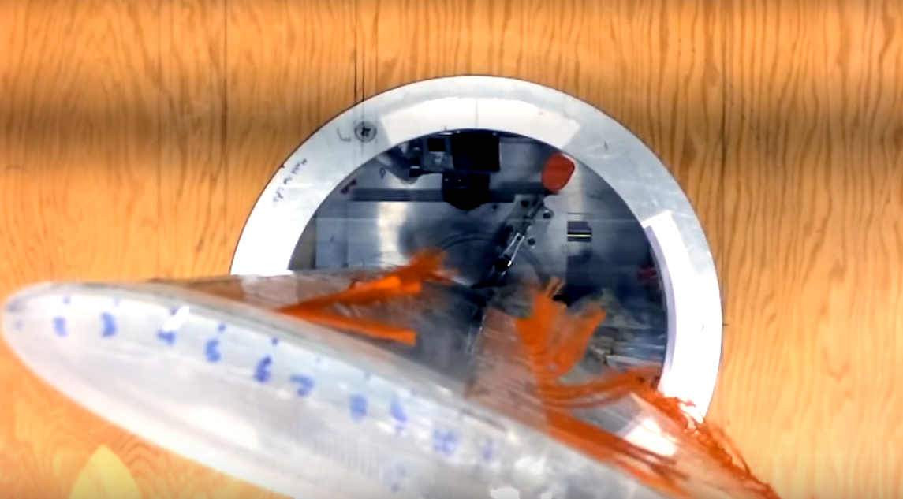
Applications
Separation control on airfoils
Unless we have something better; this movie is pretty decent:
https://www.youtube.com/watch?time_continue=113&v=sV9RiEJvUrc&feature=emb_logo

Slide 7
Applications
[Anything else cool to show?]

Slide 8
Demo
[Here I’ll program a control panel for the user to play with the system. This is a basic layout:]
Default
Waves
Frequency: 1.5 cycles/sec
[User would be able to manually
draw the waveform samples in
the chart to play with the waveform]
Amplitude [V]
Amplitude: 1V
100%
0%
% cycle

